Slide 1
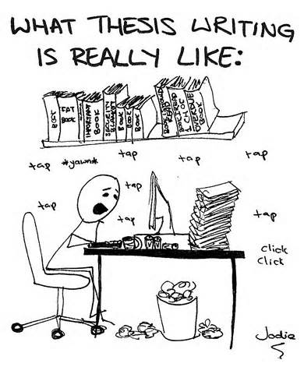
Thesis Writing
Rhetorical Analysis

Slide 2
Developing a thesis
Be careful that you aren’t too broad/general
In his inaugural address, JFK employs rhetorical devices to set the stage for his term as the 35th president.
In his inaugural address, JFK employs rhetorical devices to keep the attention of his audience despite the cold weather.
Avoid personal opinion
Despite the cold weather, JFK effectively utilizes rhetorical devices that foreshadow his greatness as president.
Despite being so short, JFK’s inaugural address is effectively devised with important rhetorical devices.
Aim for addressing the prompt in a clear, focused statement
*see next slide for possibilities

Slide 3
The Thesis: Closed vs. Open Thesis statements
CLOSED
A thesis that previews the major points to be made
“closed” because it limits the writer to the points broached
It’s helpful for short essays written in response to a prompt and under time constraints, as it assists you as the writer to develop a blue print and stick to it
Ex: Through antimetabole, asyndeton, and anaphora JFK calls upon
Americans to join him in a commitment to pursue a united country
and world.
OPEN
A thesis that does NOT list main points
A thesis most effective for a longer essay with multiple main points (to mention them all in the thesis would be bulky/awkward)
Ex: His employment of rhetorical strategy in his inaugural address
allows JFK to elicit support for his platform of social responsibility
both domestically and abroad.

